Slide 1
iBLESS
Project's Name: iBLESS
Team Members: Luis Miguel Carrillo
Roles: Scrum Master, and Team Member
Mentor: Jaime Borras

Slide 2
Problem Definition
Missing calls/text messages.
No system to manage users.
No way of visualizing data.
No way of connecting to android app.

Slide 3
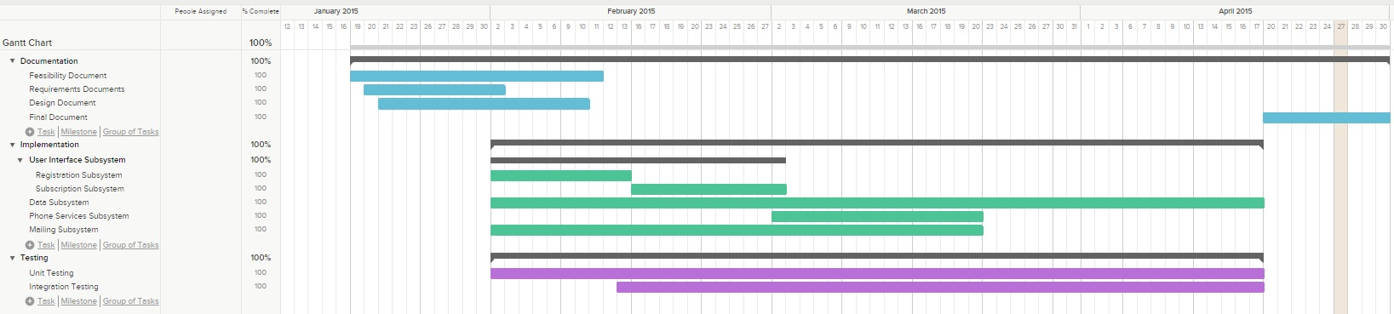
Project Management

Slide 4
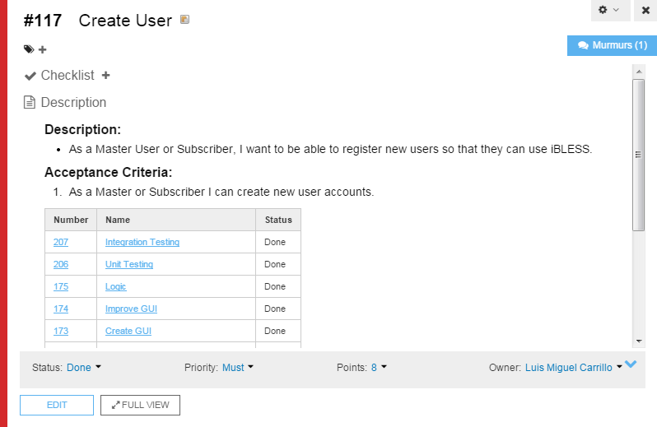
User Stories

Slide 5
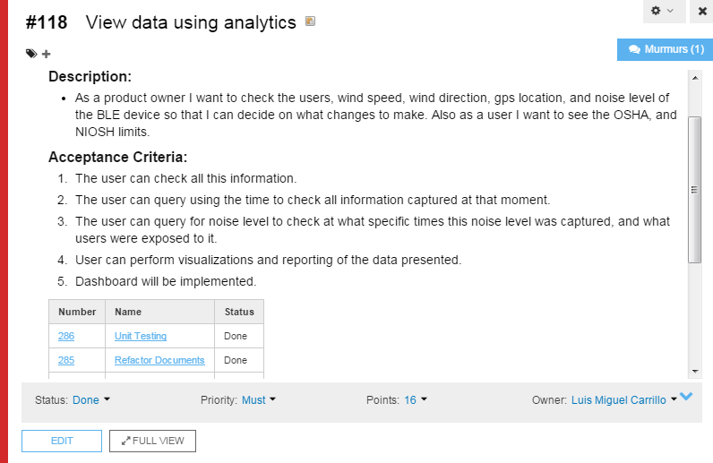
User Stories

Slide 6
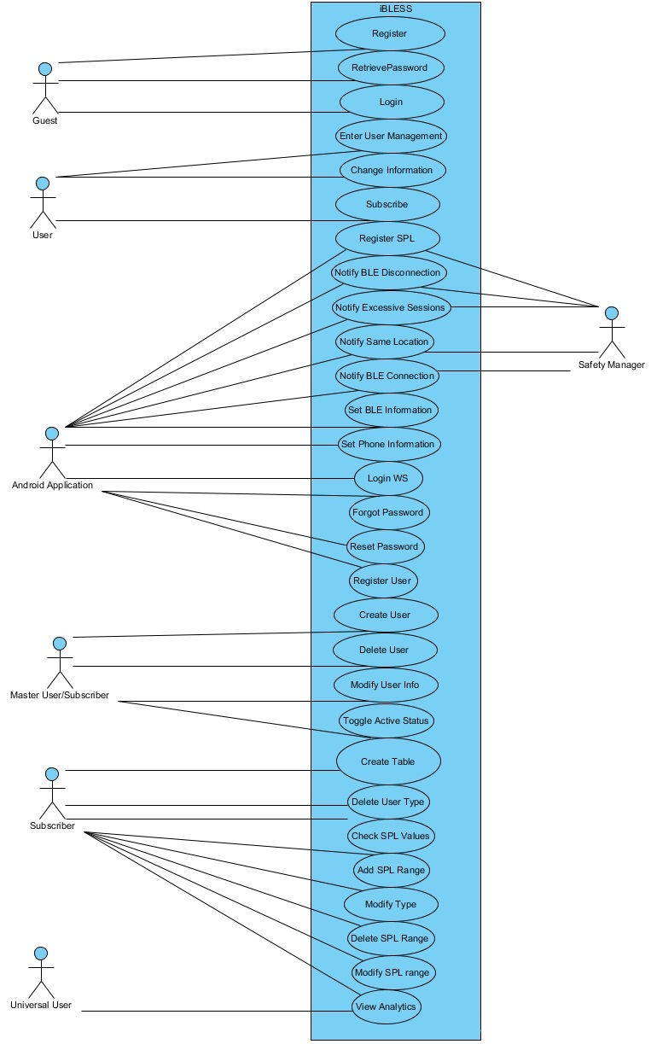
Use Case Diagram

Slide 7
Use Cases
Use case name Create User
Participating actors Master User/Subscriber
Flow of events 1. The Master User accesses the “Create User” function of the website.
2. iBLESS responds by presenting a form to the User.
3. The Master User fills out the form by typing username, firstname, lastname, e-mail address, address, city, state, zip code, cellphone number, parent, userType, employeeID, and jobTitle. The Master User clicks submit.
4. iBLESS receives the information, validates it, and creates a user account under the Master User table and a user account under the general table. The table is refreshed so that the Master User can see the new user added.
Entry condition The Master User is inside the “Create User” function of the website, and has created a hierarchy in the “Create Table” function of the website.
Exit condition The Master User sees the new user listed in the table.
Quality requirements The new user is created in less than 2 seconds.
User Story Card: #117

Slide 8
Use Case
Use case name View Data Using Analytics
Participating actors Universal User
Flow of events 1. The Universal User accesses analytics.
2. iBLESS responds by presenting a form to the User.
3. The Universal User provides the username and password.
4. iBLESS responds by validating the information and presenting a form to the User.
5. The Master User clicks in the analytics label that they want to review.
6. iBLESS responds by presenting a form to the User.
7. The Master User types or clicks the filters to use in the query.
8. iBLESS responds by showing all data available that fulfill the criteria provided by the User.
Entry condition The Universal User is inside the “Analytics” section of the system.
Exit condition The Universal User has reviewed all the information based on the filters.
Quality requirements The queries are attractive and responsive.
User Story Card: #118

Slide 9
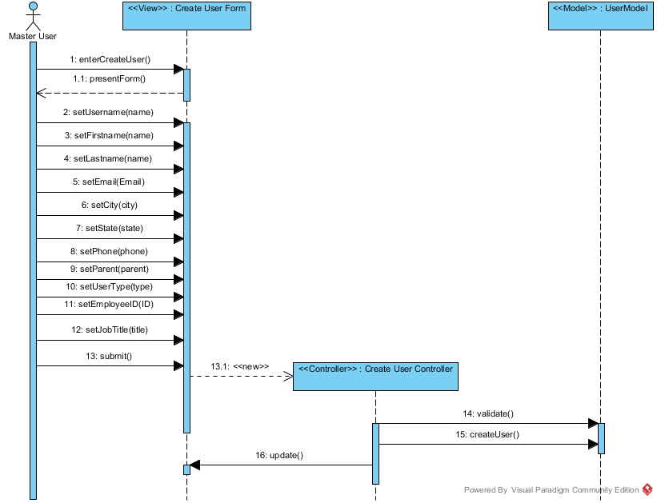
Sequence Diagrams

Slide 10
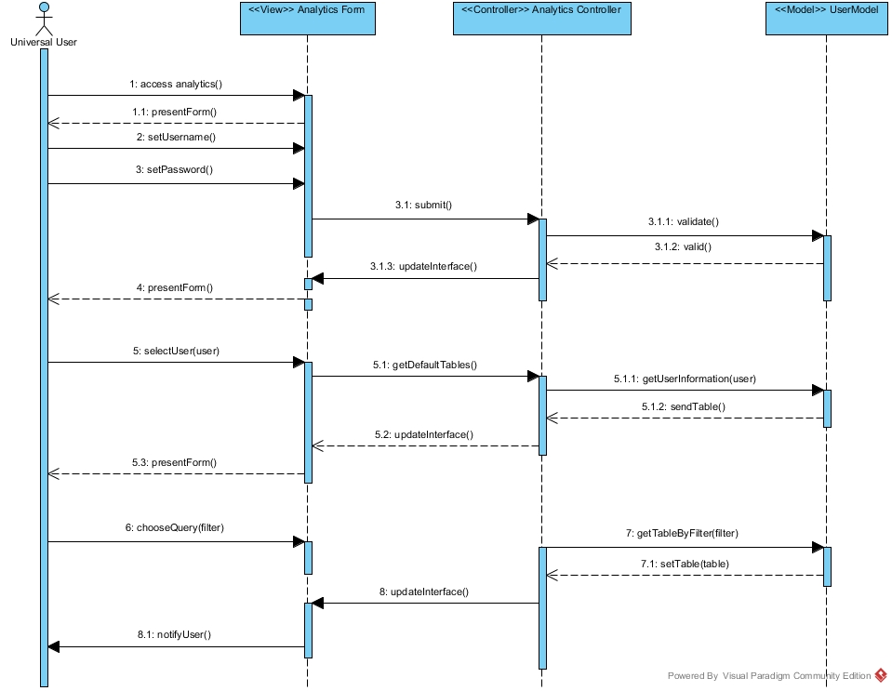
Sequence Diagrams

Slide 11
System Decomposition
Three Tier System
Separates view, logic, and data
Decreases coupling

Slide 12
System Deployment
Hardware:
PC with Windows 7
BLE Device
Smartphone with Android OS
Software:
Github
Mingle
Visual Studio
Twitter Bootstrap Framework
Amazon Web Services
Dashbuilder

Slide 13
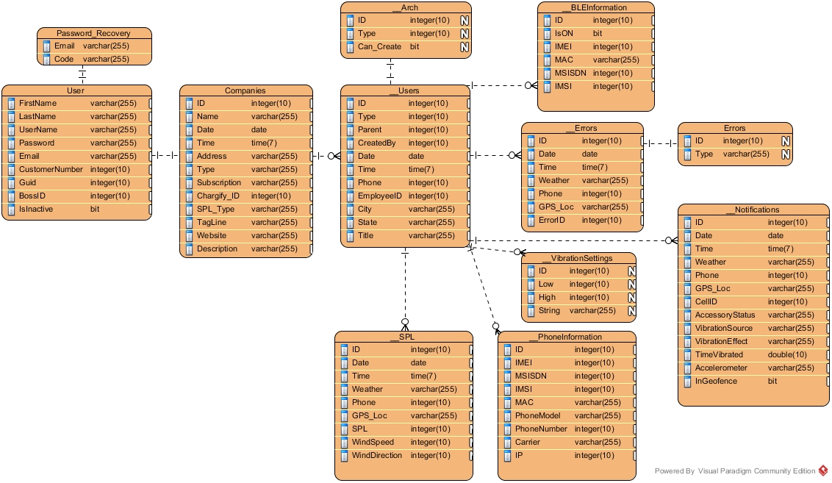
Persistent Data Design

Slide 14
Security and Privacy
SHA-1 Encryption
Amazon Web Services Database
Parametrized Queries

Slide 15
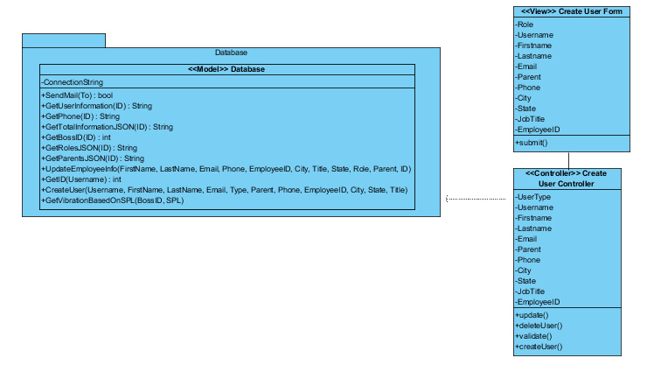
Minimal Class Diagram: Create User

Slide 16
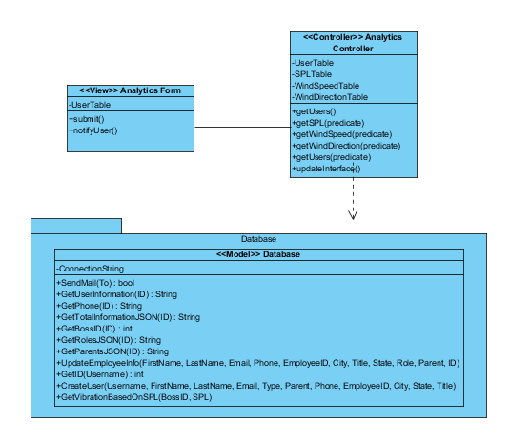
Minimal Class Diagram: Analytics

Slide 17
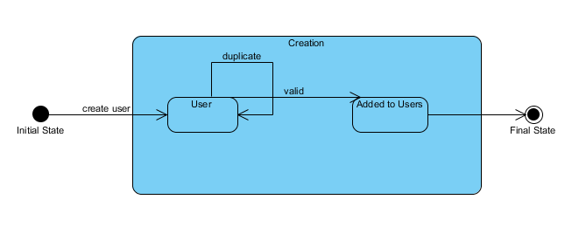
State Machine Diagram: Create User

Slide 18
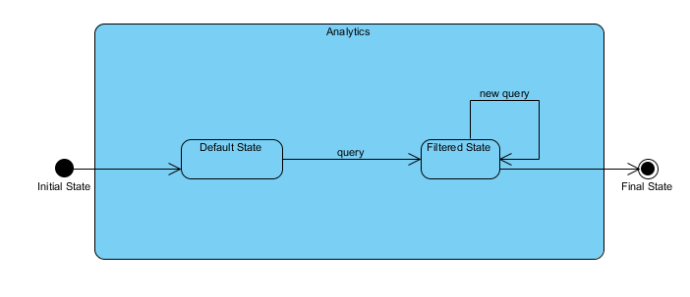
State Machine Diagram: Analytics

Slide 19
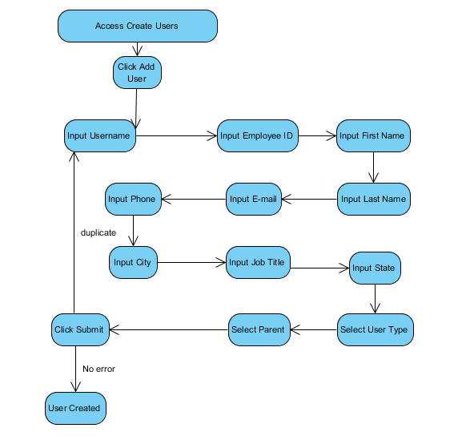
Main Algorithm: Create User

Slide 20
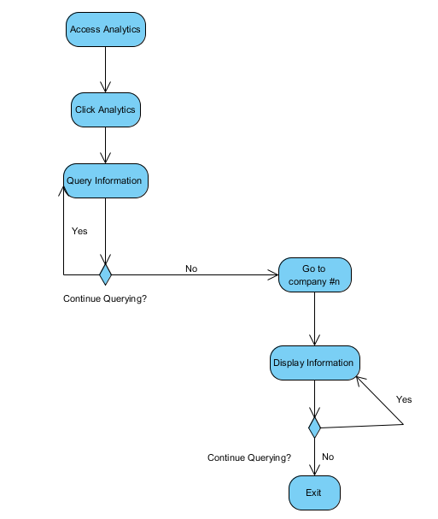
Main Algorithm: Analytics

Slide 21
Test Cases
Tested Use Case: Create User Sunny Day
Purpose:
Validate that users are able to create new users under company account. Validate that users are notified when duplicating information at moment of user creation.
Test Setup Environment:
Tested on production environment. Link: http://ibless.io
Test Input(s):
username: newuser123
firstname: newuser123
lastname: new
e-mail: newuser123@gmail.com
role: manager's
parent: 1510
address: 123
phone: 1234567899
Expected Output(s):
User is created, and current user is able to see the update in table.
Actual Output(s):
User is created, and current user is able to see the update in table. (TEST PASSED)

Slide 22
Test Cases
Tested Use Case: Create User Rainy Day
Purpose:
Validate that users are able to create new users under company account. Validate that users are notified when duplicating information at moment of user creation.
Test Setup Environment:
Tested on production environment. Link: http://ibless.io
Test Input(s):
username: newuser123
firstname: newuser123
lastname: new
e-mail: newuser123@gmail.com
role: manager's
parent: 1510
address: 123
phone: 1234567899
Expected Output(s):
User is not created. Current user is notified that there is duplication of unique information.
Actual Output(s):
User is not created. Current user is notified that there is duplication of unique information. (TEST PASSED)

Slide 23
Test Cases
Tested Use Case: Analytics Sunny Day
Purpose:
Validate that users can filter information by inputting filtering constraints.
Validate that if users input invalid constraints no filtering takes place.
Test Setup Environment:
Tested on production environment.
Test Input(s):
avg. spl from 0 to 150
Expected Output(s):
Filtered information is displayed.
Actual Output(s):
Filtered information is displayed. (TEST PASSED)

Slide 24
Test Cases
Tested Use Case: Analytics Rainy Day
Purpose:
Validate that users can filter information by inputting filtering constraints.
Validate that if users input invalid constraints no filtering takes place.
Test Setup Environment:
Tested on production environment.
Test Input(s):
avg. spl from word to word2
Expected Output(s):
No constraint is applied.
Actual Output(s):
No constraint is applied. (TEST PASSED)

